Slide 1
predict if a email is spam using logistice regression MACHINE LEARNING PROJECT
NAME : NIKHITA R PATTAR
COURSE : BCA 5TH SEM
INSTITUTE : DIGITIAL DREAMS OF INSTUTION

Slide 2
Problem Statement
“
Spam emails are unwanted messages.
Goal: Classify email as Spam or Not Spam
”

Slide 3
Dataset Description
Dataset includes:
- Email text
- Label: Spam (1) / Not Spam (0)

Slide 4
Technique Used: Logistic Regression
Steps:
- Text Preprocessing (Tokenization, Stopwords Removal)
- Feature Extraction (TF‑IDF)
- Apply Logistic Regression Model
- Evaluate Accuracy

Slide 5
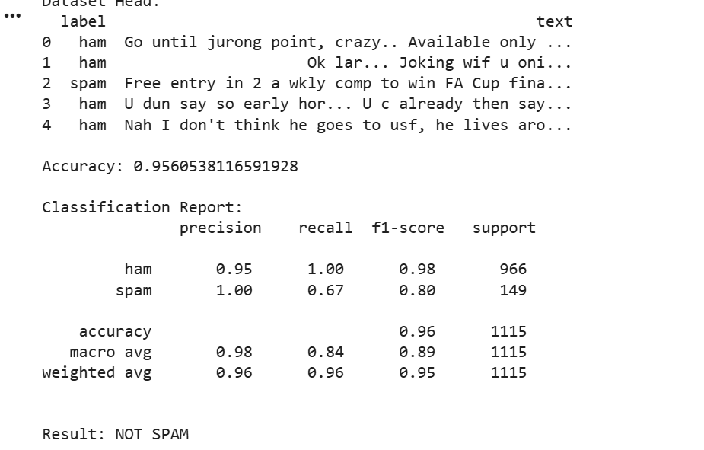

Slide 6
Conclusion
Model predicts spam with good accuracy.
Helps in filtering emails automatically.

